Slide 1
Application of Coordinate Systems
3D
Presented By:
Chai Sheng Loong 240378
Neoh Hai Liang 245807
Chia Wei Shin 246365

Slide 2

Rectangular Coordinate :
Imaginary Axis is REAL

Slide 3

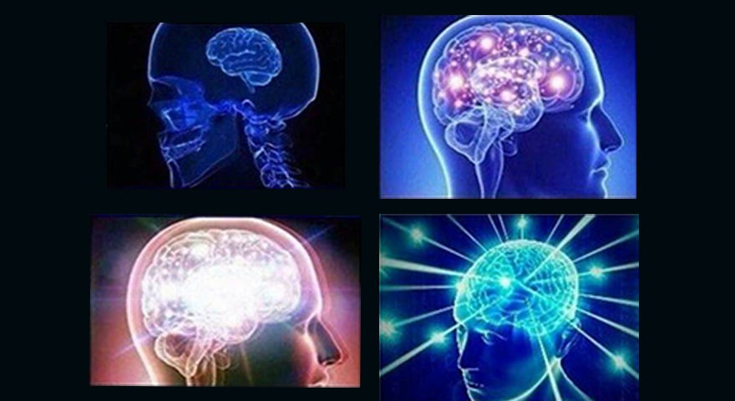
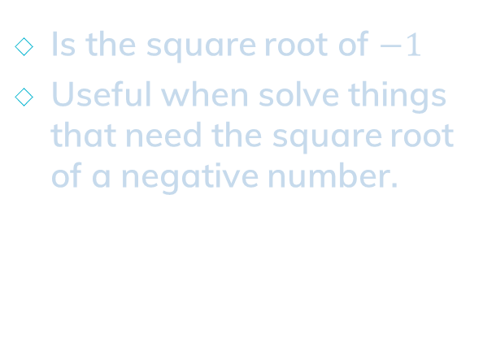

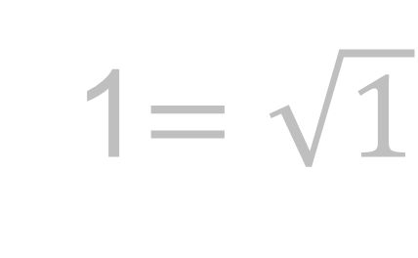
Imaginary Number
$$i=\sqrt{−1}$$
1$=\sqrt{1}$
Is the square root of $−1$
Useful when solve things that need the square root of a negative number.

Slide 4
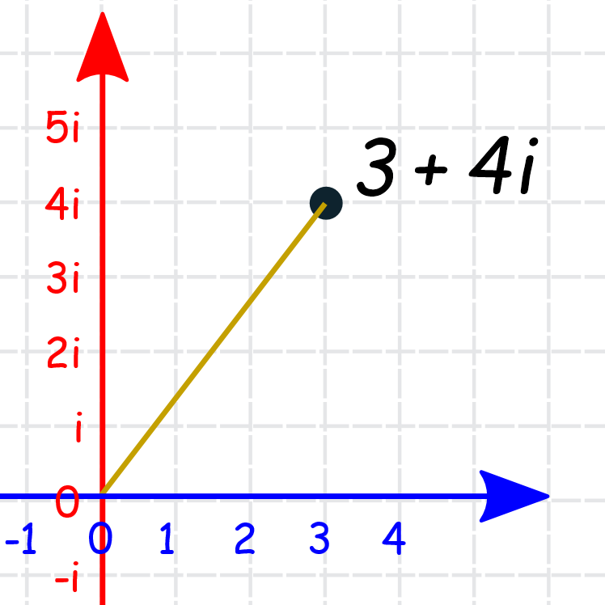
Complex Plane
Is the plane of complex numbers spanned by the vectors 1 and i, where i is the imaginary number.
expressed in the form a + bi
a - the real portion of the complex number
b - the imaginary portion of the complex number

Slide 5
The Real-Complex 3D Plane??!!
Reference: https://www.youtube.com/watch?v=T647CGsuOVU

Slide 6

Cylindrical Coordinate :
Hue-Saturation-Brightness (HSB)
Colour Space Model

Slide 7
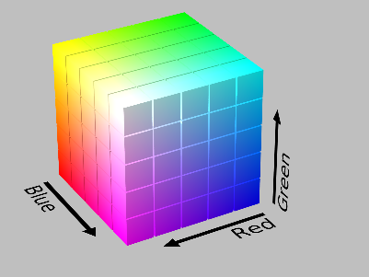
How computer graphic shows colour?
Additive color model
3 types of primary colours
RGB Colour Space Model

Slide 8
How human recognize a colour?
How Strong the colour is?
What colour is this?
How Bright the colour is?
💃

Slide 9
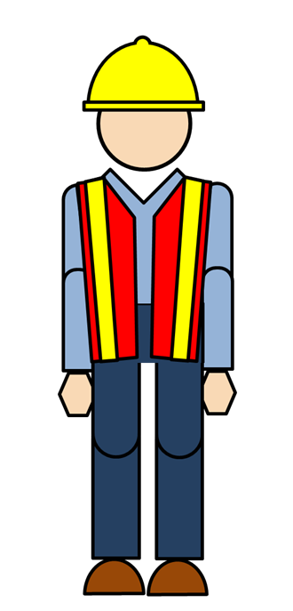

VS

Slide 10
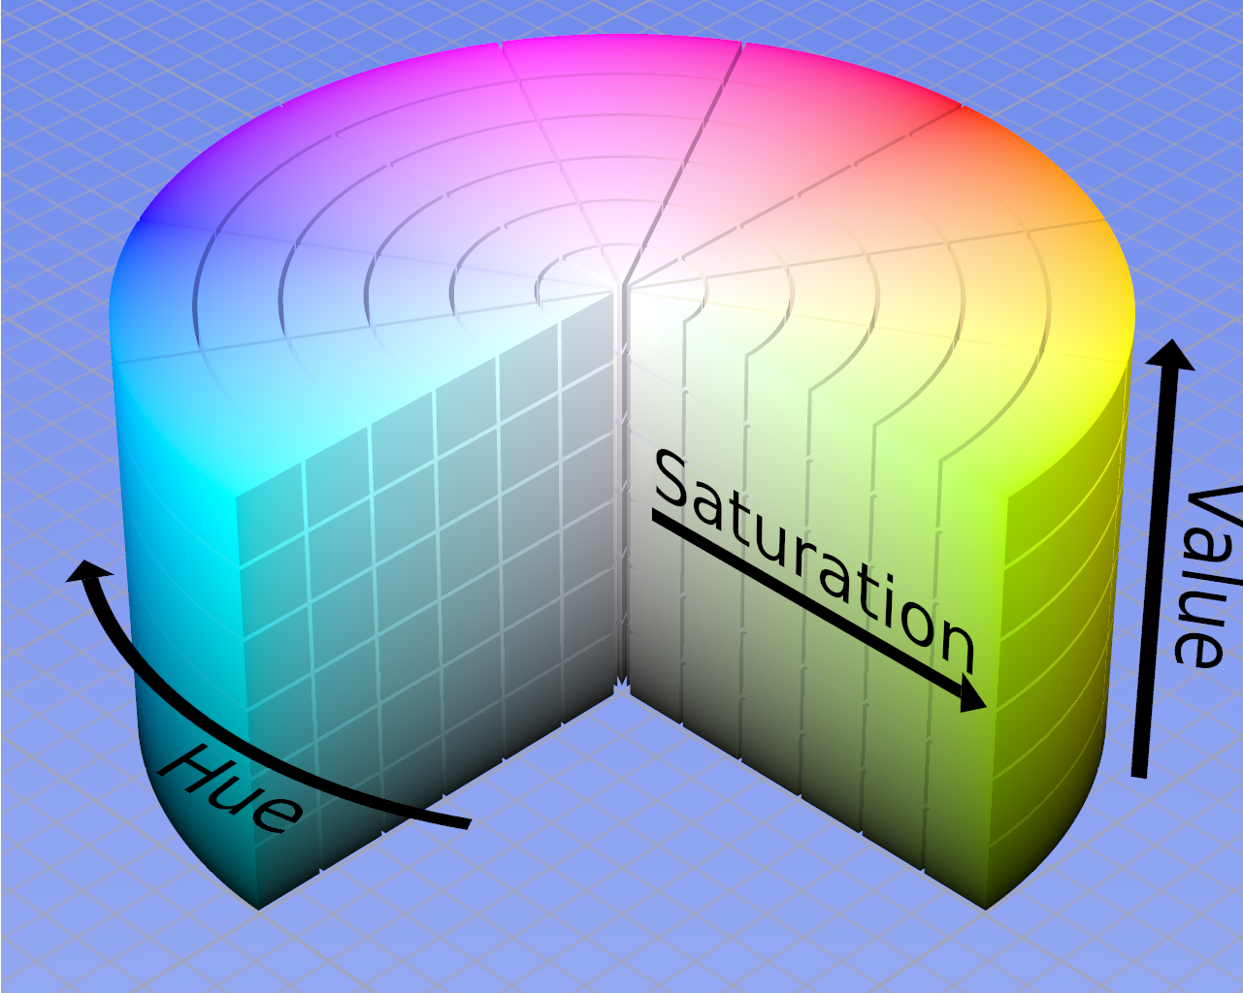
HSB Colour Space
Hue – Saturation –Brightness
Cylindrical Coordinate System
Stores colours’ attributes in “human way”.

Slide 11
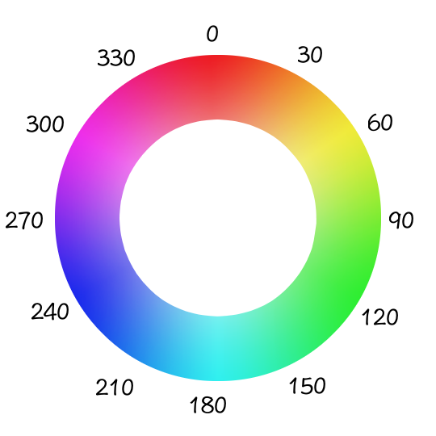

Slide 12
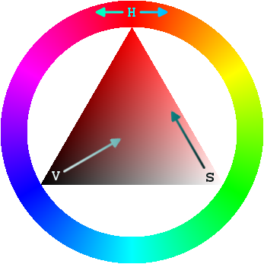
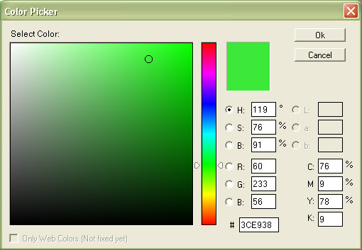
Application of HSB Model
GIMP
Adobe Photoshop

Slide 13
Spherical Coordinate :
🌏
Geographic Coordinate System &
Time Zone

Slide 14
Longitude and latitude are imaginary lines that circle the Earth.
These lines are located on maps and measured in degrees and each degree is divided into 60 minutes.

Slide 15
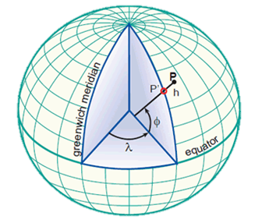

Slide 16
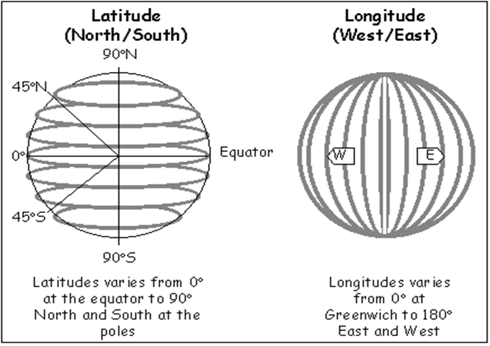

Slide 17
Time Zone will only be influenced by the changes of longitute but not latitude.

Slide 18
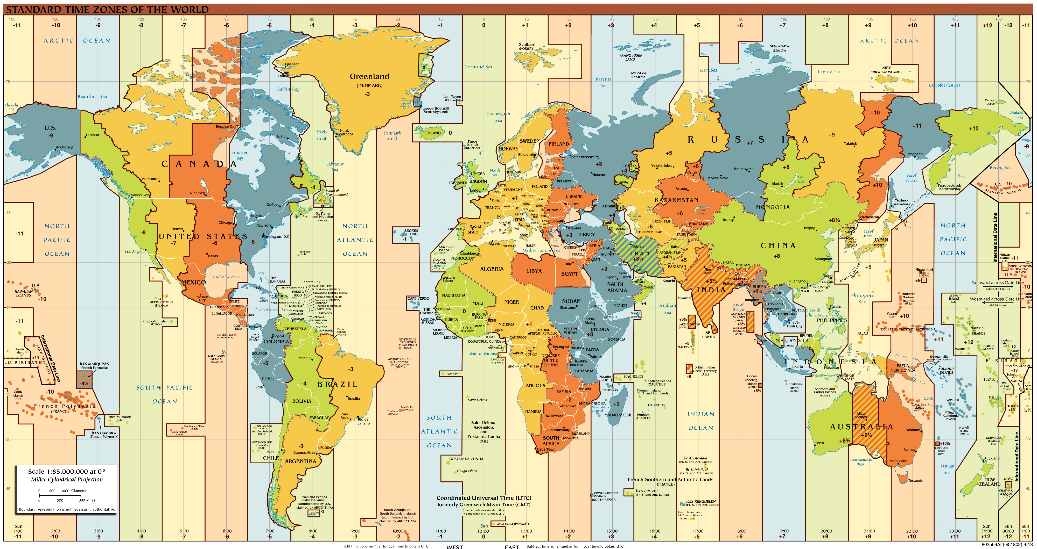

Slide 19
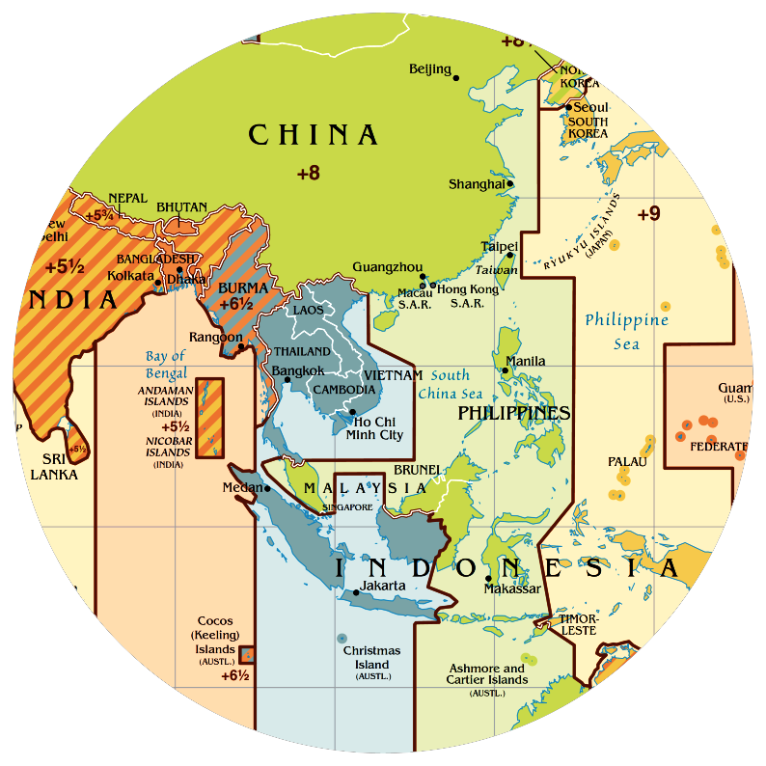

Slide 20


